Slide 1
Geometry
L. C. Chapon

Slide 2
Instrument
Should be able to built virtual instrument from individual components and their positions, orientations either absolute or relative to other components (à la McStas)
Should have hierarchical structure.
Some elements are Assembly themselves
z
A
y
Z’
x
Transform
Y’
B
X’

Slide 3
Assembly
Assembly are particularly useful for complex geometrical definitions.
Also logical components, such a modules, banks, groups…
Example: GEM
Module A
Module A
Group 1
Module A
Module A
Module A
Typical GEM detector module:
120 detectors back and front
Many modules of the same type grouped in banks…

Slide 4
Instrument
Should be able to use the virtual instrument definition for Monte-Carlo simulations.
  Need to define what we want to do with Monte-Carlo?
    Do we pipeline components (McStas style)?
    Do we define scattering volumes….. Which allow for multiple scattering, background calculations…..
    (In Geant4, they have support for surfaces as well as volume)
Should be able to provide 3D representation of the instrument (light CAD).
Do we want interactive graphics?

Slide 5
Instrument Status
We probably need to make a distinction between objects with relatively different lifetimes.
Instrument is quite static in the sense that its physical components (or logical components) do not change often.
However some of the components parameters can vary:
  from run to run
    Working detectors on the instrument, noisy ones…
    Sample position or orientation…
    a chopper frequency …
  Within a single run
    scan with detector on a moving arm
    polarization in different periods

Slide 6
Instrument Diagnostics
Should be able to run algorithms to determine or refine instrument parameters:
  Example: refine engineering positions of the detectors from a calibration run and update the instrument geometry
Should be able to plot selected parameters (example count inside a detector, offsets…)

Slide 7
Algorithms
Many algorithms will require parameters from:
  The physical components geometry info. (position, orientation).
  The physical component parameters.
  Example: algorithm that transform t.o.f to wavelength for all spectra only in the valid wavelength range will require the positions of all detectors but also the chopper frequency, opening angle…
    Note: Using a generic description of components other than detectors is something we don’t really do at the moment but we should be doing it…

Slide 8
Mapping spectra-detector element
Each pixel or (pixelassembly) has a uid that is related to the detector
In most cases, there is a one-to-one mapping between a pixel and a spectrum but it is not always true:
  Pixels can be grouped together and related to a single spectra.
  This is done either electronically and therefore this information is already contained in the raw file or this is the result of a user operation
  Instruments like maps groups quite often in 2x2 adjacent pixels
  On GEM electronic grouping is done sometimes to speed-up the dead-time when doing time-resolved studies.
Notation: pixel is a unitary detector elements

Slide 9
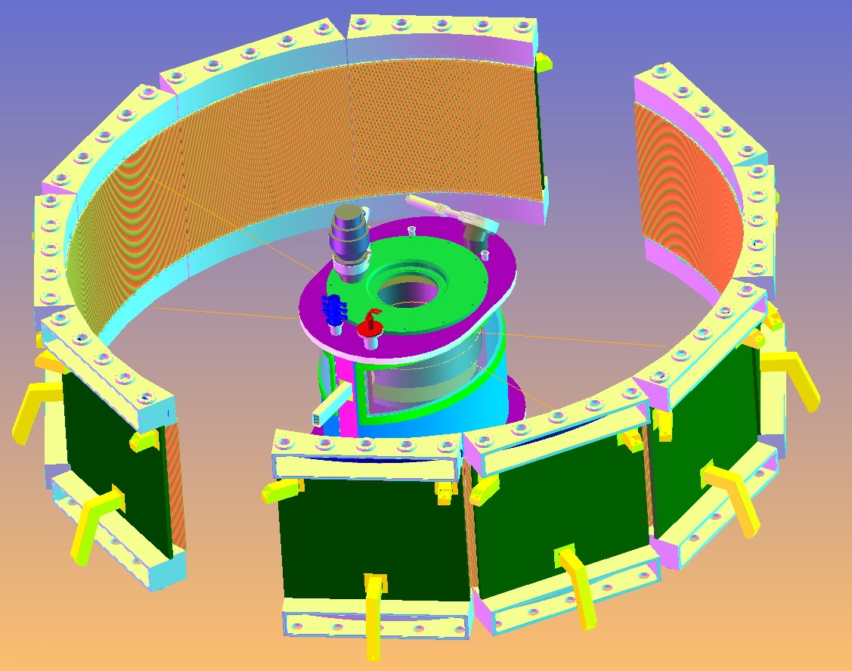
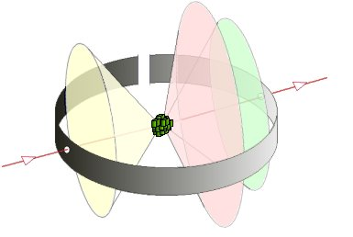
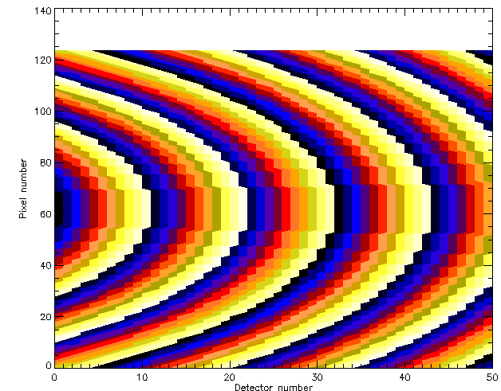
Mapping between physical pixel and logical pixels
The mapping is sometimes quite complex,
For example on WISH several pixels belonging to different physical PSD tubes
Are grouped into a single spectrum.

Slide 10
Support Classes
Euclidian geometry:
3D vector
3x3 matrices (or 4x4)
Quaternion
Transform
Surface, ray, volumes…
Do we need to check for valid geometry, check for overlapping components? → bounding box ?
What is required and more is included in Geant4.

